Slide 1

Prediction of diabetes using machine Learning
Team
Bala subra Maniyan s r 71051907006
Swedha b 71051907026
TharunKumar s 71051907027
Vijay s 71051907029

Slide 2
Introduction
Diabetes is a common chronic disease and poses a great threat to human health. The characteristic of diabetes is that the blood glucose is higher than the normal level, which is caused by defective insulin secretion or its impaired biological effects, or both (Lonappan et al., 2007).
Diabetes can lead to chronic damage and dysfunction of various tissues, especially eyes, kidneys, heart, blood vessels and nerves (Krasteva et al., 2011).
Diabetes can be divided into two categories, type 1 diabetes (T1D) and type 2 diabetes (T2D).
Patients with type 1 diabetes are normally younger, mostly less than 30 years old. The typical clinical symptoms are increased thirst and frequent urination, high blood glucose levels (Iancu et al., 2008).
Type 2 diabetes occurs more commonly in middle-aged and elderly people, which is often associated with the occurrence of obesity, hypertension, dyslipidemia, arteriosclerosis, and other diseases (Robertson et al., 2011).
Machine learning methods are widely used in predicting diabetes, and they get preferable results.

Slide 3

ABSTRACT
The motive of this Project is to design A model which can prognosticate the likelihood of diabetes in patients with maximum accuracy.
Therefore nine machine learning classification algorithms namely Decision tree, Random forest, Logistic regression, SVM, XG-boost, Gradient boost, KNN, Gaussian NB, Adaboost are used in this experiment to detect diabetes at an early stage.
The Project has said that around 640 million patients will be undergoing diabetes in the year of 2040
With a rapid development of machine learning , It can be applied to many aspects of medical health.
In this Project, we have used 21 Attributes and more than 2 lakh of Data. which helps in prediction process.

Slide 4
Project overview
Here we have used Nine different classification algorithm.
One among those algorithm is chosen wisely according to their accuracy rate and it is used in the developing of web application.
A web application is created as the user can interact and check whether they are affected by diabetes or not. This predicts according to the input that a user gives using their medical report.
As there are two types of Diabetes , the web application shows the result after undergoing the analysis and displays whether the person is suffering from Type-I , Type – II or No diabetes.

Slide 5
Literature Survey
S.NO | PAPER NAME | JOURNAL NAME | AUTHORS | OBSERVATION | ACCURACY
1. | Comprehensive Review of Various Diabetic Prediction modules. | Journal of Healthcare Engineering Volume 2022 Article : 8100694 | Roshi Saxena , Sanjay Kumar Sharma, Manali Gupta, G. C. Sampada | A comparison of the three feature selection technique and six machine learning classifiers has been made, and the ensemble of AdaBoost and gradient boost gave the best results. | Dataset :768 Algorithm Used : GB, AB, RF, DT, KNN. Attributes : 8 Accuracy : 78.9%
2. | Implementation of a Web Application to Predict diabetes diseases. An Approach using Machine Learning Algorithm. | International Conference of Computer and Information Technology – 2018 | Samrat Kumar Dey Ashraf Hossain Md. Mahbubur Rahman | Created a Web Application for the Successful Prediction. ANN provides Highest accuracy. | Dataset : 768 Algorithm used : ANN, SVM, naïve Bayes. Attributes : 8 Accuracy : 82.35%

Slide 6
3. | Diabetes Prediction using Machine Learning. | Ijraset - Journal for Research in applied science and Engineering Technology 2022 | Ashwini R, S M Ayesha Afshin, Kavya V, Prof. Deepthi Raj | They have made use of SVM, KNN, Logistic Regression and Random forest. | Dataset : 769 Accuracy : 70%
4. | ML based Web App for Diabetes Prediction. | International Research Journal of Engineering and Technology Volume 08, Issue: 05/May 2021 | Dr. V Rajesh Maheta Nasreen Bagde Prasad solase Ankit Yadav | They have used Random Forest Algorithms with less dataset | Dataset : 769 Accuracy : 72.5%
5. | Diabetes Prediction using Machine Learning Algorithms | International Conference on Recent Trends in Advanced Computing 2019 | Aishwarya Mujumdar Dr. Vaidehi v | On using various machine learning algorithm Logistic Regression as given the highest Accuracy | Dataset : PIMA Accuracy : 95%
6. | Research on Diabetes Prediction method based on machine learning. | Journal of Physics : AINIT 2020 | Jingyn Xue, Fanchao min, Fengying ma | SVM has the highest accuracy through the confusion matrix evaluation test. | Accuracy : 95.6%
Richard Branson

Slide 7
EXISTING SYSTEM
A comparison of the three feature selection technique and six machine learning classifiers has been made, and the ensemble of AdaBoost and gradient boost gave the best results.
Different Research paper made use of different algorithms and they shown each algorithm has a predicted highest accuracy.
But the major drawback of these research are everyone made use of a particular dataset PIMA which contains 789 datasets and 8 attributes.
per, the existing system makes use of 768 dataset containing 8 attributes and shows an accuracy of 78.9%.
The major limitation that the existing model has is less amount of dataset and the unwanted faulty information from users.

Slide 8
Proposed System
The proposed system develops a classification and predictive model that will perform accurate classification grouping and prediction of Diabetes. This Proposed system approach will focus on prediction of the diabetes in the early stage by taking 21 real world value parameters of patients medical report.
The proposed system makes use of Nine different Algorithms and classification is made.
A comparison is done and the best Algorithm is chosen wisely and a Web application is created as per the selected Algorithm.

Slide 9

MODULES
Algorithm.
1.Decision Tree.
2. Random Forest.
3. Logistic Regression.
4. Support Vector Machine.
5. XG-Boost
6. Gradient Boost.
7. KNN
8. Gaussian NB.
9. Adaboost.
Web Application Modules.
1.Flask
2. HTML
3. CSS
4. Bootstrap
5. JavaScript
Database Modules

Slide 10
Decision Tree
Decision Tree is a Supervised learning technique that can be used for both classification and Regression problems, but mostly it is preferred for solving Classification problems.
It is a tree-structured classifier, where internal nodes represent the features of a dataset, branches represent the decision rules and each leaf node represents the outcome.
Formulas
ENTOPHY : Entropy(s)= -P(yes)log2 P(yes)- P(no) log2 P(no)
Gini : 1- ∑_{j}P_{j}²

Slide 11


Slide 12
RANDOM FOREST
Random Forest is a popular machine learning algorithm that belongs to the supervised learning technique. It can be used for both Classification and Regression problems in ML. It is based on the concept of ensemble learning, which is a process of combining multiple classifiers to solve a complex problem and to improve the performance of the model.
Random Forest Classifier:
A random forest is a meta estimator that fits a number of classifying decision trees on various sub-samples of the dataset and uses averaging to improve the predictive accuracy and control over-fitting. The sub-sample size is controlled with the max_samples parameter if bootstrap=True (default), otherwise the whole dataset is used to build each tree.

Slide 13
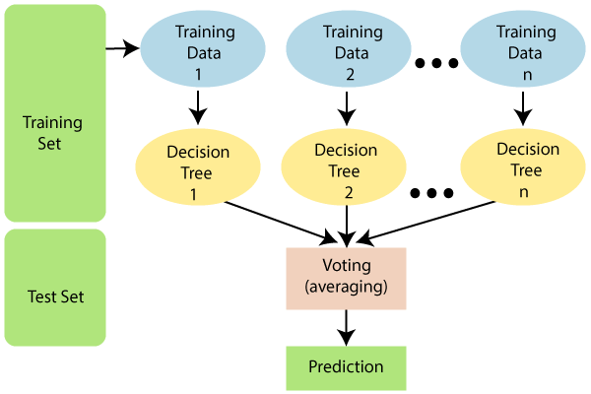

Slide 14
Logistic Regression
Logistic regression is one of the most popular Machine Learning algorithms, which comes under the Supervised Learning technique. It is used for predicting the categorical dependent variable using a given set of independent variables.
Logistic regression predicts the output of a categorical dependent variable. Therefore the outcome must be a categorical or discrete value. It can be either Yes or No, 0 or 1, true or False, etc. but instead of giving the exact value as 0 and 1, it gives the probabilistic values which lie between 0 and 1.
Logistic Regression:
This class implements regularized logistic regression using the ‘liblinear’ library, ‘newton-cg’, ‘sag’, ‘saga’ and ‘lbfgs’ solvers. Note that regularization is applied by default. It can handle both dense and sparse input. Use C-ordered arrays or CSR matrices containing 64-bit floats for optimal performance; any other input format will be converted.

Slide 15
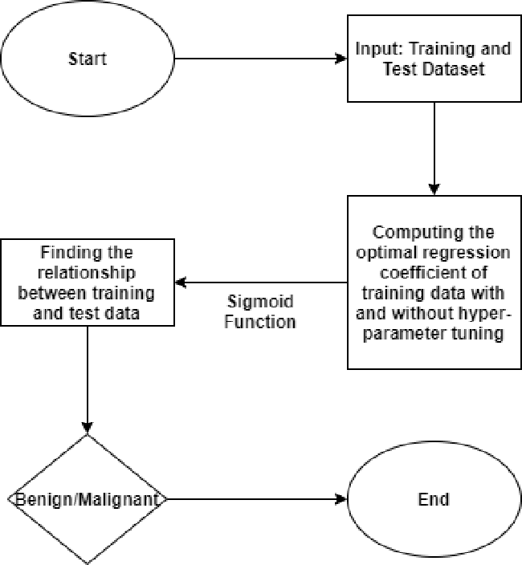

Slide 16
Support vector machine
Support Vector Machine or SVM is one of the most popular Supervised Learning algorithms, which is used for Classification as well as Regression problems. However, primarily, it is used for Classification problems in Machine Learning.
The goal of the SVM algorithm is to create the best line or decision boundary that can segregate n-dimensional space into classes so that we can easily put the new data point in the correct category in the future. This best decision boundary is called a hyperplane.
Pandas , Numpy and Matplotlib for data manipulation ,mathematical computations and visualizations of data.
SUPPORT VECTOR MACHINE COMPARISON(SVM) :
SVC and NuSVC implement the “one-versus-one” approach for multi-class classification. In total, n_classes * (n_classes - 1) / 2 classifiers are constructed and each one trains data from two classes. To provide a consistent interface with other classifiers, the decision_function_shape option allows to monotonically transform the results of the “one-versus-one” classifiers to a “one- vs-rest” decision function of shape (n_samples, n_classes).

Slide 17
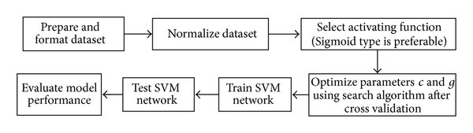

Slide 18
XG-boost
XG-Boost is an implementation of Gradient Boosted decision trees. XGBoost models majorly dominate in many Kaggle Competitions.
In this algorithm, decision trees are created in sequential form. Weights play an important role in XG-Boost. Weights are assigned to all the independent variables which are then fed into the decision tree which predicts results. The weight of variables predicted wrong by the tree is increased and these variables are then fed to the second decision tree. These individual classifiers/predictors then ensemble to give a strong and more precise model. It can work on regression, classification, ranking, and user-defined prediction problems.

Slide 19
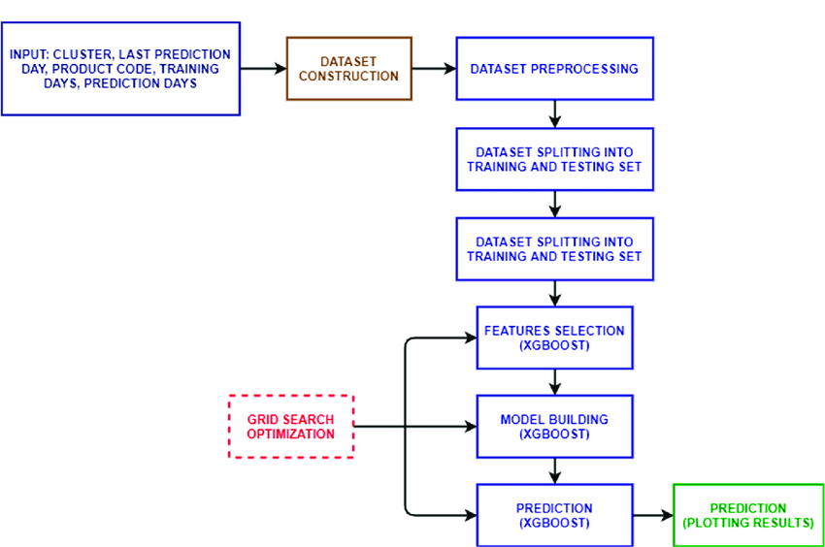
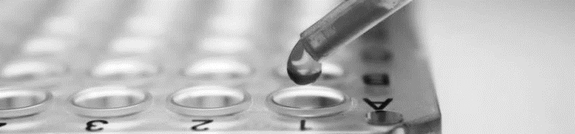

Slide 20
Gradient boosting
Gradient Boosting is a popular boosting algorithm. In gradient boosting, each predictor corrects its predecessor’s error. In contrast to Ad boost, the weights of the training instances are not tweaked, instead, each predictor is trained using the residual errors of predecessor as labels.
There is an important parameter used in this technique known as Shrinkage.
Shrinkage refers to the fact that the prediction of each tree in the ensemble is shrunk after it is multiplied by the learning rate (eta) which ranges between 0 to 1. There is a trade-off between eta and number of estimators, decreasing learning rate needs to be compensated with increasing estimators in order to reach certain model performance. Since all trees are trained now, predictions can be made.

Slide 21
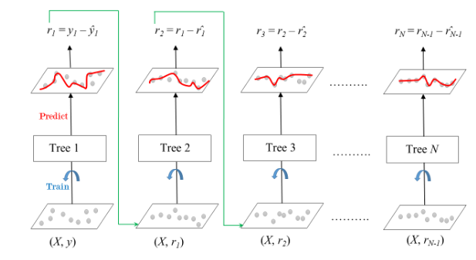

Slide 22
KNN
K-Nearest Neighbour is one of the simplest Machine Learning algorithms based on Supervised Learning technique.
K-NN algorithm assumes the similarity between the new case/data and available cases and put the new case into the category that is most similar to the available categories.
K-NN algorithm stores all the available data and classifies a new data point based on the similarity. This means when new data appears then it can be easily classified into a well suite category by using K- NN algorithm.
K-NN algorithm can be used for Regression as well as for Classification but mostly it is used for the Classification problems.
K-NN is a non-parametric algorithm, which means it does not make any assumption on underlying data.
It is also called a lazy learner algorithm because it does not learn from the training set immediately instead it stores the dataset and at the time of classification, it performs an action on the dataset.

Slide 23
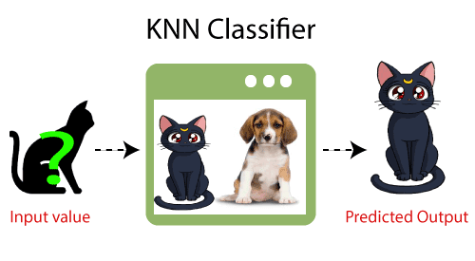

Slide 24
Gaussian Naïve Bayes
Gaussian Naïve Bayes is the extension of naïve Bayes. While other functions are used to estimate data distribution, Gaussian or normal distribution is the simplest to implement as you will need to calculate the mean and standard deviation for the training data.
A Gaussian Naive Bayes algorithm is a special type of NB algorithm. It’s specifically used when the features have continuous values. It’s also assumed that all the features are following a gaussian distribution i.e, normal distribution.

Slide 25
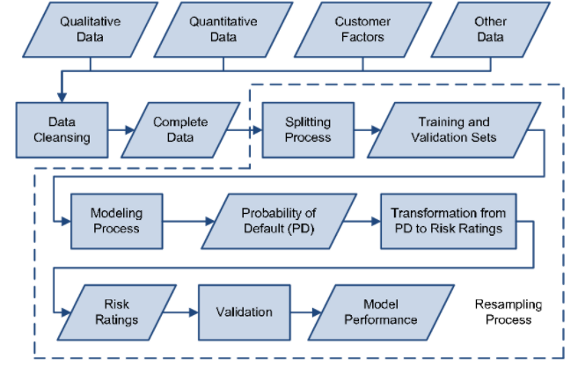

Slide 26
Ada-boost
AdaBoost, short for Adaptive Boosting, is a statistical classification meta-algorithm formulated by Yoav Freund and Robert Schapire in 1995, who won the 2003 Gödel Prize for their work. It can be used in conjunction with many other types of learning algorithms to improve performance.
AdaBoost is adaptive in the sense that subsequent weak learners are tweaked in favor of those instances misclassified by previous classifiers. In some problems it can be less susceptible to the overfitting problem than other learning algorithms. The individual learners can be weak, but as long as the performance of each one is slightly better than random guessing, the final model can be proven to converge to a strong learner.

Slide 27
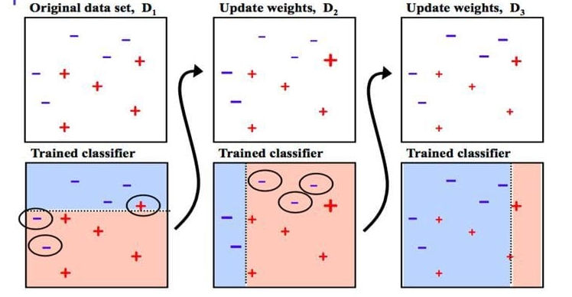

Slide 28
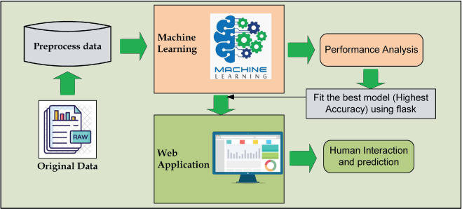
Data Flow Diagram- Web application

Slide 29
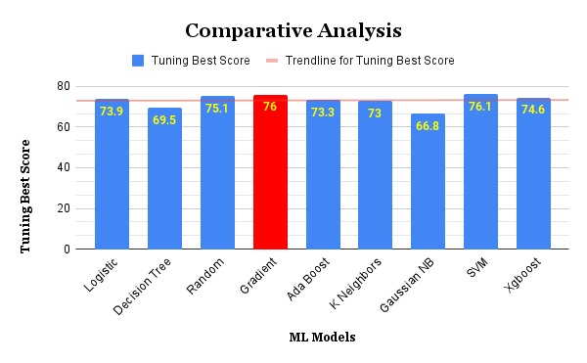
COMPARATIVE ANALYSIS OF CLASSIFICATION ALGORITHMS AND THEIR ACCURACY

Slide 30
RESULT
We proposed a web-based application for the successful prediction of Diabetes Diseases. From different machine learning algorithms Gradient Boost with Standard Scaling Method and Hyperparameter Tuning provide us highest accuracy. As we have proposed and developed an approach for diabetes disease prediction using machine learning algorithm, it has significant potential in the field of medical science for the detection of various medical data accurately.
After predicting the best accuracy that specified algorithm that’s Gradient Boost is used in creating a Web Application for the better user.
The result page in the web application consist of Three types
1. result0 – No Diabetes
2. result1 – Type –I Diabetes
3. result2 – Type –II Diabetes.

Slide 31
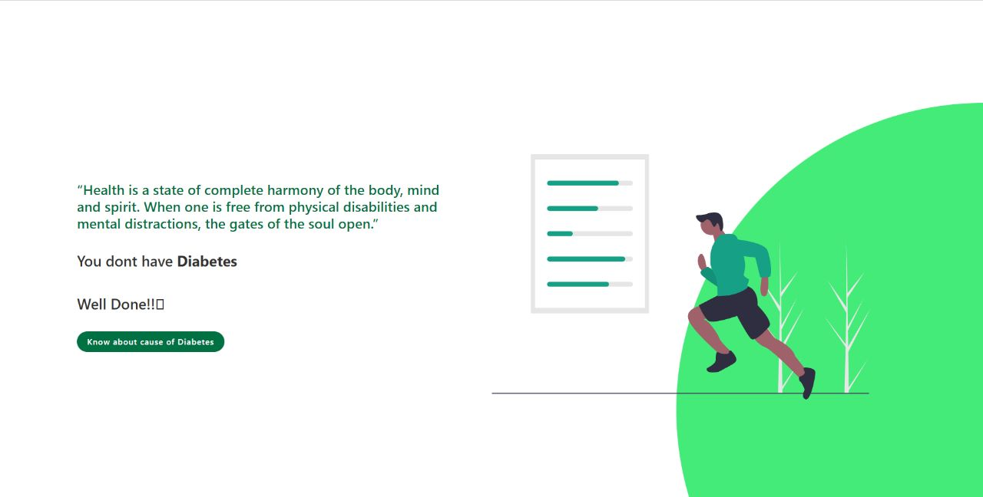
Result 0 Page

Slide 32
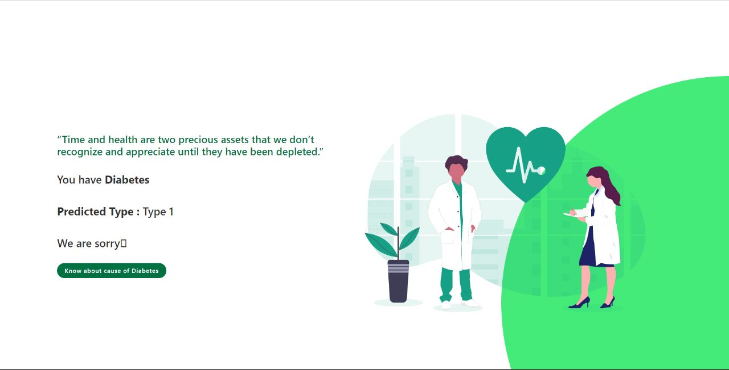
Result 1 Page

Slide 33

Result 2 -Page

Slide 34

Applications
This project is used to diagnose the diabetes prediction in the medical field.
Especially, we used different classification algorithms to predict the diabetes.
Two stages :
i. TYPE 1 insulin dependent diabetes mellitus
ii. TYPE 2 diabetes mellitus and adult-onset diabetes.
The easy way to know whether a person is affected by diabetes and the type they got. Which may help them to take medication in earlier stage.

Slide 35
Summary
In this project, we examined different classification algorithms and techniques for predicting the diabetes using a web application. We performed a comparative analysis of Decision Tree, Random Forest, Logistic Regression, Support Vector Machine Comparison(SVM), AdaBoost, XG-Boost, KNN, Gaussian NB, Gradient Boost It was observed that XG-Boost performs the existing methods when it comes to accuracy, precision and also size of the data set.
Future Work
In the Future work this project is further developed in the fields like data visualization, the list of hospitals is added in the web application. The nearest treatment centre and the best centre with budget friendly is also to be added.
The we application is to be made secured like only a valid user will be allowed to make use of the web application which works on authentication process.
This can be further Enhanced to improve the model in the next phase like including the Doctor’s Information for direct contact in case of Emergency.

Slide 36
Reference
[1]. Statista Number of smartphone users worldwide from 2016 to 2021. Available from https://www.statista.com/statistics/330695/number-of-smartphone-users-worldwide/. Accessed 1 April 2020
[2]. Hood M, Wilson R, Corsica J, Bradley L, Chirinos D, Vivo A. What do we know about mobile applications for diabetes self-management? A review of reviews. J Behav Med 2016;39:981–994 [PubMed] [Google Scholar]
[3]. Business of Apps App download and usage statistics 2019. Available from https://www.businessofapps.com/data/app-statistics/. Accessed 29 March 2020
[4]. Annie A. Report: the state of mobile 2020. Available from https://www.appannie.com/en/go/state-of-mobile-2020/. Accessed 29 March 2020
[5]. Statista Number of mHealth apps available in the Apple App Store from 1st quarter 2015 to 3rd quarter 2019. Available from https://www.statista.com/statistics/779910/health-apps-available-ios-worldwide/. Accessed 30 March 2020
[6]. Statista Number of mHealth apps available at Google Play from 1st quarter 2015 to 3rd quarter 2019. Available from https://www.statista.com/statistics/779919/health-apps-available-google-play-worldwide/. Accessed 30 March 2020
[7]. Istepanian RSH, Laxminarayan S, Pattichis CS, Eds. M-Health: Emerging Mobile Health Systems. Boston, MA, Springer, 2006 [Google Scholar]

Slide 37
[8]. World Health Organization mHealth: New horizons for health through mobile technologies: based on the findings of the second global survey on eHealth. Available from www.who.int/goe/publications/goe_mhealth_web.pdf. Accessed 31 March 2020
[9]. Fleming GA, Petrie JR, Bergenstal RM, Holl RW, Peters AL, Heinemann L. Diabetes digital app technology: benefits, challenges, and recommendations: a consensus report by the European Association for the Study of Diabetes (EASD) and the American Diabetes Association (ADA) Diabetes Technology Working Group. Diabetes Care 2020;43:250–260 [PubMed] [Google Scholar]
[10]. Association of Diabetes Care & Education Specialists It’s here! DANA app review. Available from https://www.diabeteseducator.org/news/perspectives/aade-blog-details/molly-mcelwee-malloy/2018/02/05/it's-here-dana-app-review. Accessed 16 April 2020
[11]. European Commission Transformation of health and care in the digital single market. Available from https://ec.europa.eu/digital-single-market/en/policies/ehealth. Accessed 19 September 2018
[12]. Van Norman GA. Drugs and devices: comparison of European and U.S. approval processes. JACC Basic Transl Sci 2016;1:399–412 [PMC free article] [PubMed] [Google Scholar]
[13]. U.S. Food and Drug Administration Policy for device software functions and mobile medical applications: guidance for industry and Food and Drug Administration staff. Available from https://www.fda.gov/media/80958/download. Accessed 6 April 2020.

Slide 38

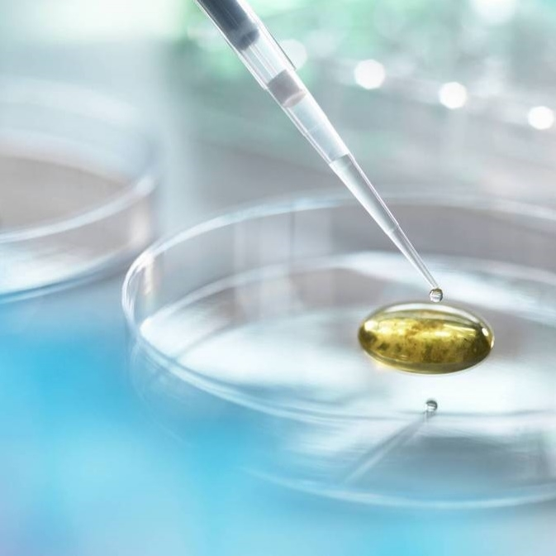
Thank you

